Slide 1

Support Model

Slide 2
Support Framework Overview
Purpose: To establish a current & future state support model to help guide teams as they transition to a Dev Ops model.
Assumptions:
This framework is designed to provide an 80% representation of support related activities
Framework deviations may exist due to org & model maturity or unique business needs
Where deviations exist, our goal is to work towards framework alignment over time
This content is intended for communication within TTS only.

Slide 3
Background
The Support Services area is a collection of Level 1, level 2 and some level 3 Support functions , Operational functions and Compliance function that span the entire Target portfolio (applications and infrastructure)
About 70% of the teams efforts goes to Incident, Monitoring and event management with the remaining 30% going to run functions
In 2014 they handled 400,000 incidents and 2.3million events. Both of which have been growing as 10%-15% annually
The footprint for the support functions is 534 resources in total (not including leaders) of which 65% is application oriented and 35% is infrastructure oriented. (excludes digi and marketing)
85% of the team is contractors of which 80% are located offshore.

Slide 4
Current State Ownership for Support Activities
Monitoring & Event Mgmt.
Support Accept
Run Functions
Incident
Problem
Vendors
Vendor incident restoration
Problem Fixes
Vendor training / documentation
Customer Advocate
Build & Delivery
Dev/ Infra incident restoration
Design for BSOH requirements
Hardware Deployment and Maintenance
Establish monitor standards
Design Modification
Problem Prioritization
Problem RCA
High severity
SWAT activities
Transition support knowledge to Support Services
Deploy code and Patches Package
Support Services
Event tuning & Correlation
System Monitoring & Maintenance
H Time to Restore and Cost L
Verify BSOH / accept support
Escalated “SME” Incident Restoration
Escalated “SME” Restoration
Problem Identification
Cyclical & LTO Events
Transition support to offshore
Major Incident Management Process
Knowledge based Incident Restoration
Event Monitoring AND
Knowledge based Event Restoration
Incident Correlation
Compliance
DR Testing
Transition first call knowledge to CSC
Validation Testing
CSC
Platform / Product Tuning
Accept first call knowledge
Record incident

Slide 5
Organizational Ownership Changes for Support Activities
Incident
Monitoring & Event Mgmt.
Support Accept
Run Functions
Problem
Vendors
Vendor incident restoration
Problem Fixes
Vendor training / documentation
Customer Advocates
Build & Delivery
Incident Elimination
Design for BSOH requirements
Establish monitor standards
Hardware Deployment and Maintenance
Design Modification
Problem Prioritization
Problem RCA
High severity
SWAT activities
Transition support knowledge to Support Services
Deploy code and Patches Package
Monitoring & Event Build, Tuning and Correlation
System Monitoring & Maintenance
H Time to Restore and Cost L
Verify BSOH / accept support
Escalated “SME” Incident Restoration
Escalated “SME” Event Restoration
Problem Identification
LTO Events
Transition support to offshore
Major Incident Management Process
Knowledge based Incident Restoration
Event Monitoring AND
Knowledge based Event Restoration
Incident & Event Correlation
Compliance
DR Testing
Transition first call knowledge to CSC & Operations
Validation Testing
Operations
Knowledge Based Cyclical Events
Accept first call knowledge
Record incident
Platform /Product Tuning

Slide 6
End State Ownership for Support Activities
Monitoring & Event
Incident
Problem
Run
Vendors
Vendor incident restoration
Problem Fixes
Solution Portfolios
Incident Elimination
Compliance Remediation/ validation
Platform /Product Tuning
Monitoring & Event Build, Tuning and Correlation
DR Testing
Full Functional Validation Testing
SWAT activities
Problem Prioritization
Infra Build
LTO Events
…
H Time to Restore and Cost L
Escalated “SME” Event Restoration
Problem Identification / RCA
Escalated “SME” Incident Restoration
Transition first call knowledge to CSC & Operations
Incident & Event Correlation
Operations
Includes CSC
Knowledge Based Incident Restoration
Knowledge Based Event Restoration
Hardware Deployment and Maintenance
System Monitoring & Maintenance
Customer Advocates
Base Validation Testing
Major Incident Management Process
Knowledge Based Cyclical Events
Record incident
Monitoring
Deploy
…

Slide 7
Use Cases
Knowledge Based Recovery
- Examples
Flex Fulfillment Stuck Orders – Operations follows defined process to remediate stuck orders
Disk Space 90% Alert : Alert gets initiated for lack of disk space. Operations executes standard process to add/create space by clearing logs or allocating space.
Register Rebuild. Operations initiates standard process to rebuild registers
GPD Device Error- Operations follows established process to triage / restore
Escalated Recovery
- Examples
Network Failure Requiring Troubleshooting – Escalated to infra team to triage/restore.
Payment Gateway Failure : One Store reports a few registers not able to accept payments. Non standard process that would be escalated to solution portfolio team to triage / restore

Slide 8

Definitions – TTS Support
Incident Management: The first goal of the incident management process is to restore a normal TTS service operation as quickly as possible and to minimize the impact on Target business operations, thus ensuring that the best possible levels of service quality, availability and data accuracy are maintained.
Another take: An unplanned interruption to an TTS Service or reduction in the quality of an TTS service. The TTS incident management process ensures that normal service operation is restored as quickly as possible and the business impact is minimized.
Monitoring & Event Management: TTS event management provides mechanisms for early detection of possible incidents, while monitoring checks the status of components even when no events are occurring. After an event has been detected it may be resolved prior to TTS impact, it may lead to a TTS incident, or it may simply be logged in case the information is needed. Response to an event may be automated or may require manual intervention.
Note: The TTS technology is configured to generate a set of events based on the design.
Problem Management: TTS problem management aims to resolve the root causes of incidents and thus to minimize the adverse impact of incidents and problems on business that are caused by errors within the TTS technology, and to prevent recurrence of incidents related to these errors. A 'problem' is the unknown underlying cause of one or more incidents, and a 'known error' is a problem that is successfully diagnosed and for which either a work-around or a permanent resolution has been identified.
Run: The purpose of the “Run” state is to coordinate and carry out the activities and processes required to deliver TTS technology to Target business users and customers. TTS teams are responsible for the ongoing management of the technology that is used to deliver and support Target business operations and manage them at agreed levels.
Note: This level is known as “Service Operation” within the ITIL framework

Slide 9
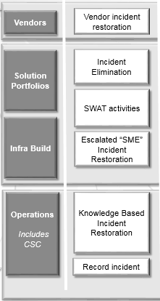
Definitions – Incident Management
Vendor Incident Management: Leveraging TTS incident management standards, practices, and tools, our Vendors restore a TTS technology as quickly as possible and to minimize the impact on Target business operations.
Incident Elimination: Following proper Problem Management practices, elimination of incidents is critical towards minimizing the adverse impact of TTS technology on Target business operations.
SWAT Activities: Situations where multiple disruptions or impacts are tied to common TTS technology solutions call for additional incident management rigor. Additional focus is needed for deeper root cause analysis and a more comprehensive solution for bringing TTS technology to a more stable state based upon agreed upon levels.
Escalated “SME” Incident Restoration: In the situation that knowledge documentation is not sufficient to restore a service or technology to agreed upon levels, subject matter experts will be leveraged to provide real-time support to ensure restoration of the incident. Upon restoration, knowledge should be reviewed and updated.
Knowledge Based Incident Restoration: Leveraging documentation developed and shared by key TTS technology owners, TTS Operations leverages TTS incident management standards, practices, and tools to restore the incident within agreed upon service levels. Based upon the TTS technology documentation, no escalation may be required.
Record Incident: Leveraging proper incident management processes, incidents are triaged, prioritized and assigned to the proper TTS team for restoration. Incident data is recorded properly to drive additional processes or ensure improvements in the future (e.g., problem management).
H Time to Restore and Cost L

Slide 10

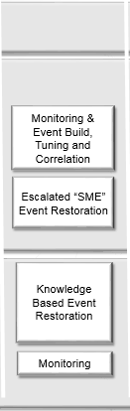
Definitions – Monitoring & Event Management
Monitoring & Event Build, Tuning and Correlation: Event management depends on monitoring, but it differs from events. Event management detects and generates notifications that require specific actions, while monitoring checks the status of TTS technology even when no events are occurring.
Leveraging TTS event management standards, practices, and tools TTS teams continuously evaluate opportunities to monitor TTS technology. An event can be defined as any detectable or discernible occurrence that has significance for the management of TTS Technology. Events need to be built, maintained, and tuned throughout their lifecycle. Events can require manual intervention or can be automated. In addition, monitoring tools are another requirement for effective TTS Operations and require TTS technology owners to build and maintain.
Escalated “SME” Event Restoration: In the situation that knowledge documentation is not sufficient to restore a service or technology to agreed upon levels, subject matter experts will be leveraged to provide real-time support to ensure restoration of the event. Upon restoration, knowledge should be reviewed and updated.
Knowledge Based Event Restoration: Leveraging documentation developed and shared by key TTS technology owners, TTS Operations leverages TTS event management standards, practices, and tools to restore the event within agreed upon service levels. Based upon the TTS technology documentation, no escalation may be required.
Monitoring: Leveraging monitoring tools and dashboards developed and shared by key TTS technology owners, TTS Operations uses these monitors to check the status of TTS technology to ensure the best possible levels of service quality and availability. These monitors can be critical windows into the health of TTS technology but if specific actions are required to maintain the health then TTS event management practices should be invoked.
H Time to Restore and Cost L

Slide 11
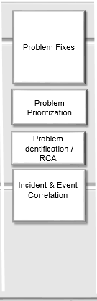
Definitions – Problem Management
Problem Fixes: The principal purpose of problem management is to find and resolve the root cause of a problem and thus prevent further incidents; Once a problem has been identified, root cause analysis has been completed, and the problem has been prioritized, TTS Strategic Vendors and TTS Technology owners must implement the fixes to eliminate the problem.
Problem Prioritization: A problem is a condition often identified as a result of multiple incidents that exhibit common symptoms. Problems can also be identified from a single significant incident, indicative of a single error, for which the impact is significant. Impact to Target business operations should be the main driver for problem prioritization to ensure those problems resulting in the largest disruption to Target business operations are dealt with. Leveraging TTS problem management standards, practices, and tools, the TTS technology owner will determine the appropriate prioritization.
Problem Identification / Root Cause Analysis: Root cause analysis is a formal problem-solving process and a critical component of Problem Management. Once a problem (or potential problem) has been identified, the root cause analysis process begins. Leveraging TTS problem management standards, practices, and tools, the TTS technology owner will complete the root cause analysis and make a determination of the problem fix and appropriate solution.
Incident Correlation: To support problem identification and prioritization, incident correlation focuses on continuous trend analysis of incidents and association of those incidents to problems (or potential problems). Leveraging TTS incident management standards, practices, and tools, the correlation of incidents to problems is an ongoing practice until the problem is implemented or the problem is documented in knowledge as a known error.
H Time to Restore and Cost L

Slide 12
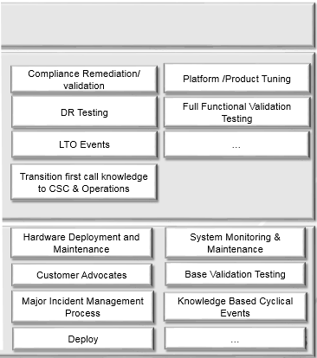
Definitions – Run
Compliance Remediation / Validation: TTS technology has been identified as requiring compliance related changes and remediation. Full validation of restored Target business operations is also required.
Disaster Recovery (DR) Testing: Cyclical testing of TTS disaster recovery policies and procedures to ensure proper response for TTS technology and mitigated impact to Target business operations.
Limited Time Offer (LTO) Events: Support of LTO events ensuring minimal to no impact to Target business operations leading up to, during, and after the event.
Transition first call knowledge to CSC & TTS Operations: To ensure the fastest response to restore TTS technology agreed upon levels, continuous transfer of subject matter expertise is required though TTS knowledge management standards, practices, and tools.
Platform / Product Tuning: Continuous tuning of TTS technology to ensure Target business operations are performing at agreed upon levels.
Full Functional Validation Testing: Upon the introduction of new or updated TTS technology, complete validation of the technology functionality is required to ensure Target business operations are performing at agreed upon levels.
H Time to Restore and Cost L

Slide 13
Definitions – Run (cont.)
Hardware Deployment and Maintenance: Support and coordination of hardware deployment and the supported maintenance activities needed for standard Target business operations.
Customer Advocates: Key advocates for Target team members to continue to monitor TTS operations and ensure the best possible levels of service quality and availability for TTS Technology
Major Incident Management Process: The Technology Operations Center will own Major Incident Management, communication and restoration.
Deploy: The act of deploying TTS technology to a run state (i.e., Production). Note: Currently a TTS Operations function today until true automation is achieved with deployment.
System Monitoring & Maintenance: As a process of maintaining healthy Target business operations standard, repeatable monitoring & maintenance activities are required to support TTS technology
Base Validation Testing: Through monitors approved and shared via TTS technology owners, base level validation will confirm that a TTS technology is operational.
Knowledge Based Cyclical Events: As a process of maintaining healthy Target business operations standard, repeatable monitoring & maintenance activities are required to support TTS technology during cyclical events throughout the calendar year (e.g., daylight savings)
H Time to Restore and Cost L

Slide 14
Appendix

Slide 15
Sizing Information
Current State Workload
2014 Annual Incident Volume - ~800K+ incidents a year.
This was up 11% over 2013
~40% restored by level 1, 45% level 2, 5% Level 3 in 2014
Only 10% - 15% of vol. deemed to be true level 2 / level 3 work
2015 trend is +2% compared 2014
2014 Annual Event Volume – ~2,300,000+ events annually
This was up 7% over 2013
22% handled by DSO/RADAR teams (level 1)
2015 trend is down 10% from 2014
Avg. Active Problems – ~2330
Transitioned to Level 3 in 2015
Current State Team Sizing
CSC (Call Center) – 250 FTE
90 Team Members – all Mpls based
160 Contractors (90 Offshore/ 70 Onshore)
HI Tech / Executive Support
11 TM
11 Contractors
Current State Team Sizing Cont…
Support Services ~ 791FTE (180 tm, 617 ct)
Down 35% YTD from 2014
Level 1 Functions (rote return to services)
TM – 8
Contractors ~362
Level 2+ Functions (Problem Solving / Performance Mgmt.)
TM - 75
Contractors ~ 89
Misc. – 97 TM, 166 CT
51 TM - Remote facility mgmt.
31 TM – Leadership
2 TM / 140 CT– DSO/Deploy
6 TM / 26 CT – STO
6 TM Canada Ramp Down
Notes:
Support services anticipates an additional 5% drawdown in support related contractors by Q4
DigiCom/Mkt/ITO
Digi – 218 (48 TM / 170 CT)
MKT – 11 (1 TM / 10CT)
ITO – 64 (10 TM / 54 CT)
TOC
Major Incident Mgmt.
21 Team Members

Slide 16
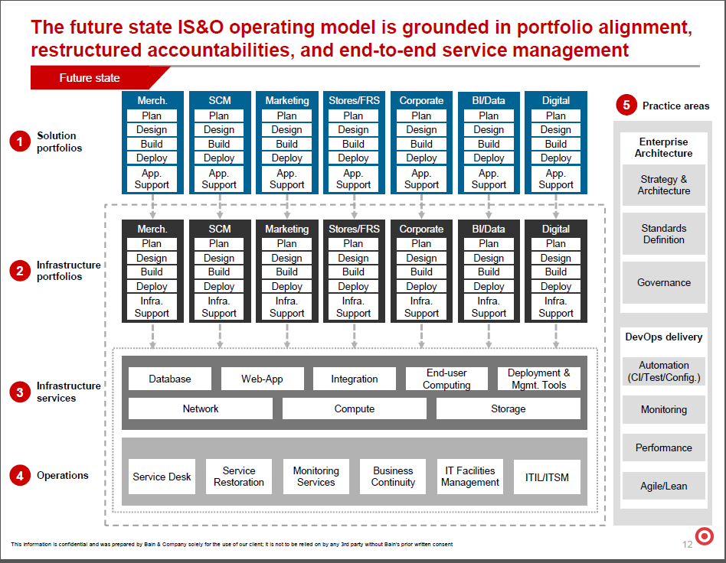

Slide 17
Sizing Information
Incident Volume Only. Does not account for all activities performed by support teams as outlined on slide 3.

